Slide 1


Name: Ken Kaya
Date: JUL/2025

Slide 2

Outline
Executive Summary
Introduction
Methodology
Results
Conclusion
Appendix

Slide 3
Executive Summary
The mission objective of this project is to analyse SpaceX launch data to discover insights and build models predicting a successful landing.
A summary of the methodologies and results described in this report is outlined as follows:
Summary of methodologies:
Data Collection through API and Web Scraping
Data Wrangling
Exploratory Data Analysis with Data Visualization and SQL
Building an interactive map with Folium
Building Dashboard with Plotly Dash
Predictive analysis (classification)
Summary of all results:
Exploratory Data Analysis results
Interactive Analytics Dashboard
Predictive Analysis Result

Slide 4
Introduction
SpaceX advertises Falcon 9 rocket launches on its website with a cost of 62 million dollars; other providers cost upward of 165 million dollars each, much of the savings is because SpaceX can reuse the first stage. Therefore, if we can determine if the first stage will land, we can determine the cost of a launch. This information can be used if an alternate company wants to bid against SpaceX for a rocket launch.
The problems in finding the answer:
Which launch sites perform best?
Which orbit and payload combinations are most successful?
Can we predict successful landings?

Slide 5

Section 1

Slide 6
Methodology
Executive Summary
Data collection methodology:
SpaceX Launch API, and Web scraping Wikipedia for additional metadata.
Perform data wrangling
Handling missing values and column renaming.
Merging multiple datasets into one DataFrame.
Feature engineering, such as orbit type, booster version, and outcome mapping.
Perform exploratory data analysis (EDA) using visualization and SQL
Perform interactive visual analytics using Folium and Plotly Dash
Perform predictive analysis using classification models
How to build, tune, and evaluate classification models

Slide 7
Data Collection
Describe how data sets were collected.
Data collection was done through SpaceX Launch API
External CSVs for booster info and payload data.
Data stored and preprocessed using Pandas.
You need to present your data collection process use key phrases and flowcharts
Task 1
Request and parse the SpaceX launch data using the GET request
Task 2
Filter the dataframe to only include “Falcon 9” launches
Task 3
Dealing with Missing Values

Slide 8
Data Collection – SpaceX API
Request data from SpaceX API
Decode response using .json() and convert to dataframe using .json_normalize()
Request information about the launches from the SpaceX API using custom functions
Create dictionary from the data
Create dataframe from the dictionary
Filter dataframe to only include Falcon 9 launches
Replace missing values of PayloadMass using .mean()
Export data to a CSV file
GitHub URL of the completed SpaceX API calls notebook https://github.com/kayaken/IBM-Data-Science-Capstone/blob/main/1.%20Data%20Collection_API.ipynb
Request data from SpaceX API
Decode response using .json() and convert to dataframe using .json_normalize()
Request information about the launches from the SpaceX API using custom functions
Create dictionary from the data
Create dataframe from the dictionary
Filter dataframe to only include Falcon 9 launches
Replace missing values of PayloadMass using .mean()
Export data to a CSV file

Slide 9
Data Collection - Scraping
Request the Falcon 9 launch Wikipedia page
Create BeautifulSoup object from HTML response
Extract all column/variable names from HTML table header
Collect data from parsing HTML tables
Create dictionary from the data
Create dataframe by parsing the launch HTML tables
Export data to a CSV file
GitHub URL of the completed web scraping notebook https://github.com/kayaken/IBM-Data-Science-Capstone/blob/main/2.%20WebScrape.ipynb
Request the Falcon 9 launch Wikipedia page
Create BeautifulSoup object from HTML response
Extract all column/variable names from HTML table header
Collect data from parsing HTML tables
Create dictionary from the data
Create dataframe by parsing the launch HTML tables
Export data to a CSV file

Slide 10
Data Wrangling
Perform EDA and determine data labels
Load data from a CSV file from an earlier session
Calculate:
Number of launches for each site in column Launch Site
Number and occurrence of each orbit in column Orbit
Number and occurrence of missing outcomes of the orbits
Create a landing outcome label from the Outcome column
Export data to a CSV file
GitHub URL of completed data wrangling-related notebooks https://github.com/kayaken/IBM-Data-Science-Capstone/blob/main/3.%20Data_Wrangling.ipynb
Perform EDA and determine data labels
Load data from a CSV file from an earlier session
Calculate:
Number of launches for each site in column Launch Site
Number and occurrence of each orbit in column Orbit
Number and occurrence of missing outcomes of the orbits
Create a landing outcome label from the Outcome column
Export data to a CSV file

Slide 11
EDA with Data Visualization
Cat Plot chart: To compare different categories or groups, often across one or more variables.
For “Payload Mass vs. Flight Number”
For “Flight Number vs. Launch Site”
Bar Plot chart: To show and compare values across discrete categories.
For “Success Rate of each Orbit Type”
Scatter Plot chart: To show relationships or correlations between two continuous variables.
For “Payload Mass vs. Launch Site”
For “Flight Number vs. Orbit Type”
For “Payload Mass vs. Orbit Type”
Line Plot chart: To track changes or trends over time.
For “Yearly Launch Success Trend”
GitHub URL of completed EDA with data visualization notebook, https://github.com/kayaken/IBM-Data-Science-Capstone/blob/main/5.%20EDA_with_DataViz.ipynb

Slide 12
EDA with SQL
Display:
The names of the unique launch sites
5 records where launch sites begin with the string 'CCA’
The total payload mass carried by boosters launched by NASA (CRS)
The average payload mass carried by booster version F9 v1.1
List:
The date when the first successful landing outcome on the ground pad was achieved.
The names of the boosters which have success in drone ship and have payload mass greater than 4000 but less than 6000.
The total number of successful and failure mission outcomes.
All the booster_versions that have carried the maximum payload mass, using a subquery with a suitable aggregate function.
The records display the month names, failure landing_outcomes in drone ship ,booster versions, launch_site for the months in year 2015.
Rank the count of landing outcomes (such as Failure (drone ship) or Success (ground pad)) between the date 2010-06-04 and 2017-03-20, in descending order.
GitHub URL of completed EDA with SQL notebook https://github.com/kayaken/IBM-Data-Science-Capstone/blob/main/4.%20EDA_with_SQL.ipynb

Slide 13
Build an Interactive Map with Folium
Launch site geolocations:
Added blue circle at NASA Jonhson Space Center’s coordinate with a popup label showing its name using its latitude and longitude coordinates.
Added red circle at all launch sites coordinates with a popup label showing its name using its latitude and longitude coordinates.
Outcome colored codes:
Added colored markers of successful (green) and unsuccessful (red) launches at each launch site to show which launch sites have high success rates
Proximity to infrastructure: roads, rails, coasts:
Added colored lines to show the distance between the launch site CCAFS SLC-40 and its proximity to the nearest coastline, railway, highway, and city
GitHub URL of completed interactive map with Folium map https://github.com/kayaken/IBM-Data-Science-Capstone/blob/main/6.%20Visual_Analytics_with_Folium.ipynb

Slide 14
Build a Dashboard with Plotly Dash
Dropdown List with Launch Sites:
Allow the user to select all launch sites or a certain launch site.
Launch success Pie charts by site:
Allow the user to see successful and unsuccessful launches as a percentage of the total.
Payload vs. outcome Scatter plot:
Allow the user to select payload mass range.
Booster-specific filters and sliders:
Allow the user to see the correction between Payload and Launch Success
GitHub URL of completed Plotly Dash lab https://github.com/kayaken/IBM-Data-Science-Capstone/blob/main/7.%20spacex-dash-app.py

Slide 15
Predictive Analysis (Classification)
Data Preparation: Cleaned and split the data into training and test sets.
Model Building and Turning: Build Logistic Regression, SVM, Decision Tree, and KNN models.
Hyperparameter Tuning: Used GridSearchCV with 10-fold cross-validation.
Model Evaluation: Measured test accuracy and plotted confusion matrices.
Model Selection: Chose the best-performing model based on the highest test accuracy.
GitHub URL of completed predictive analysis lab https://github.com/kayaken/IBM-Data-Science-Capstone/blob/main/8.%20Machine%20Learning_Prediction.ipynb
Data Preprocessing
Train-Test Split
Model Training & GridSearchCV
Test Accuracy & Confusion Matrix
Compare & Select Best Model

Slide 16
Results
Exploratory data analysis results
Interactive analytics demo in screenshots
Predictive analysis results

Slide 17

Section 2

Slide 18
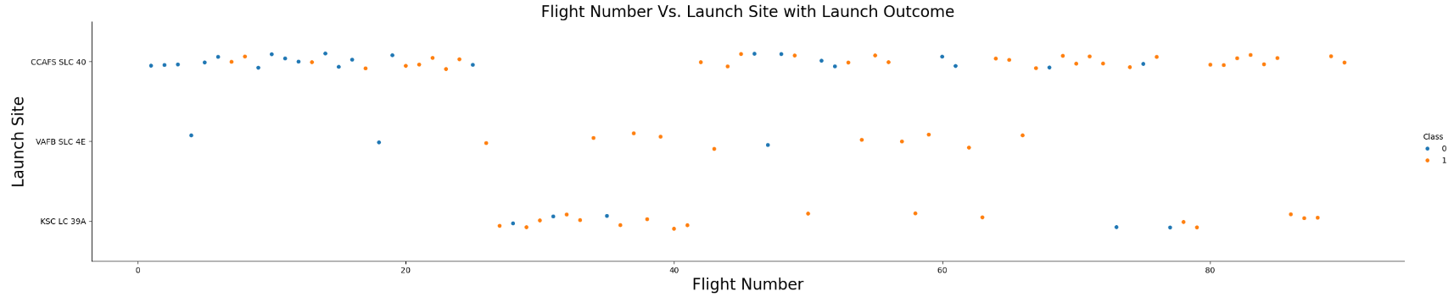
Flight Number vs. Launch Site
The greater the number of flights at a launch site, the greater the success rate at a launch site.

Slide 19
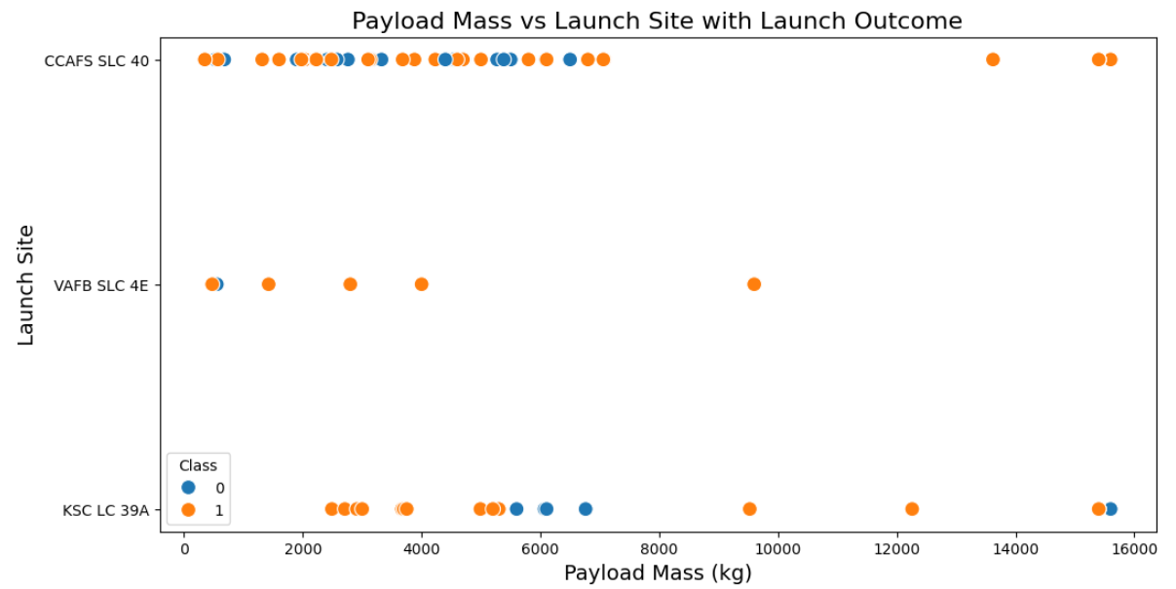
Payload vs. Launch Site
Key Findings:
Payload 4,000 - 6,000kg is most successful.
Site CCAFS SLC 40 had the best performance.
Recommendations:
Focus launches on high-performing sites.

Slide 20
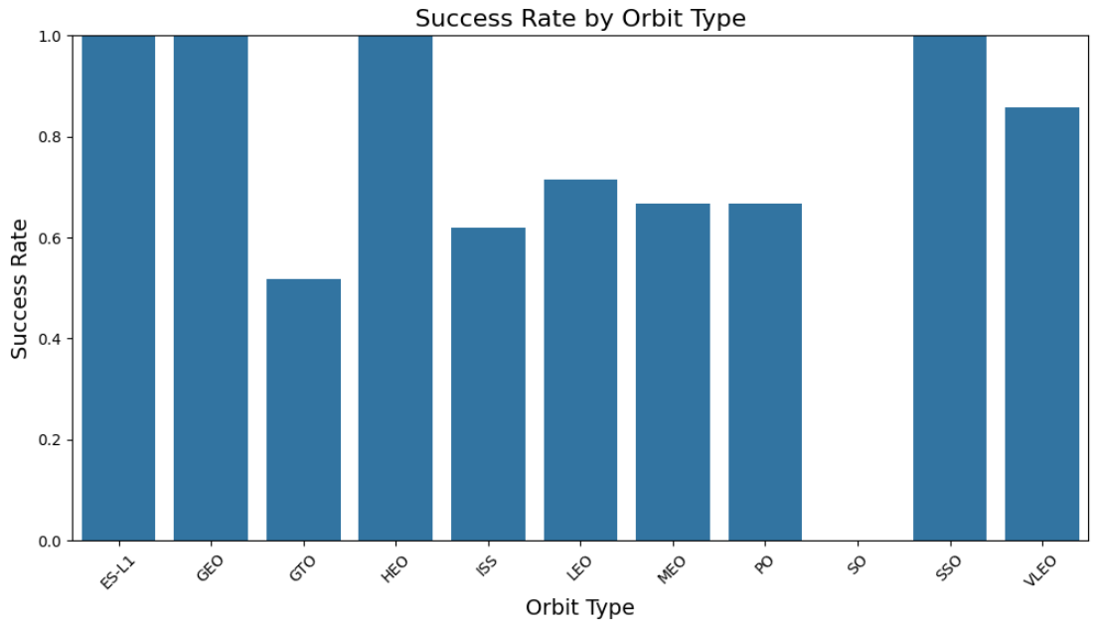
Success Rate vs. Orbit Type
100% Success Rate: GEO, HEO, SSO, ES-L1
50% - 90% Moderate Success Rate: GTO, ISS, LEO, MEO, PO, VLEO
0% Success Rate: SO

Slide 21
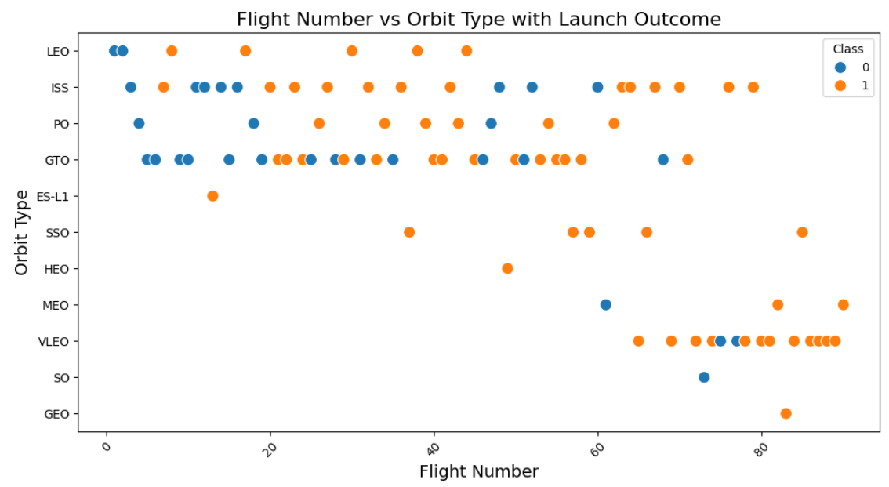
Flight Number vs. Orbit Type
LEO orbit, success seems to be related to the number of flights. Conversely, in the GTO orbit, there appears to be no relationship between flight number and success.

Slide 22
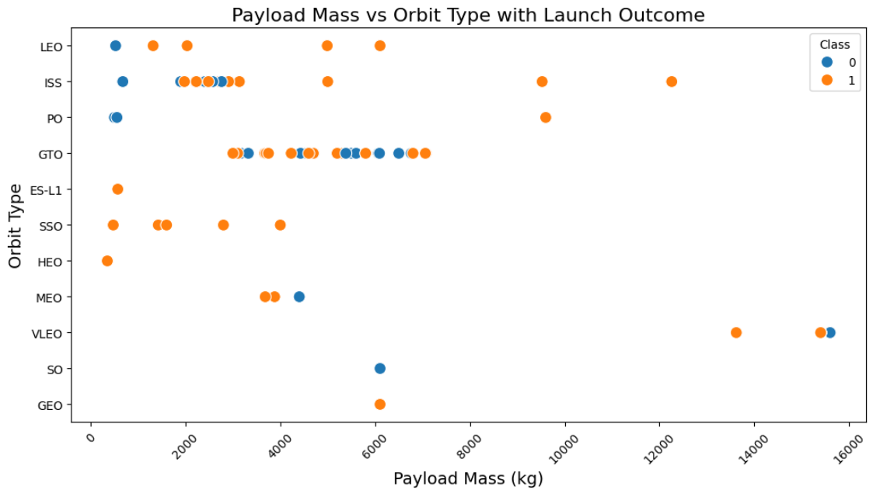
Payload vs. Orbit Type
With heavy payloads the successful landing or positive landing rate is more for Polar, LEO and ISS.
However, for GTO, it's difficult to distinguish between successful and unsuccessful landings as both outcomes are present.

Slide 23
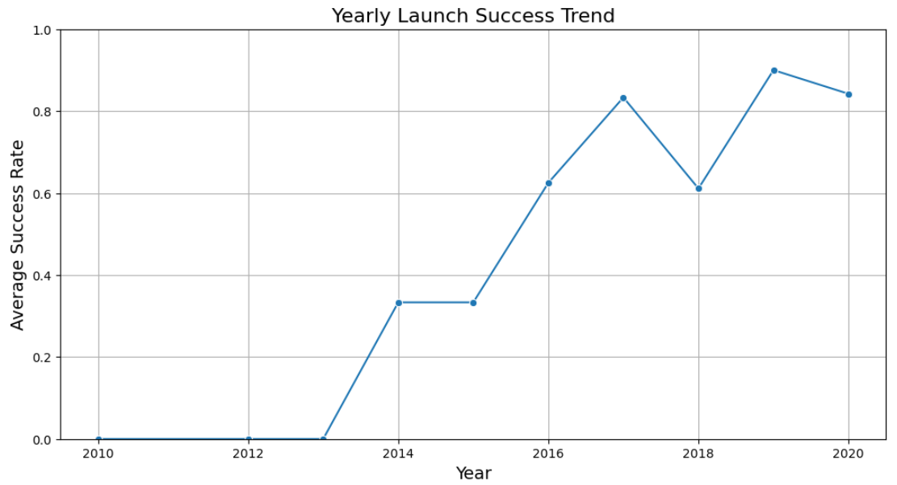
Launch Success Yearly Trend
Based on the observation that the launch success rate since 2013 has kept increasing till 2020.

Slide 24
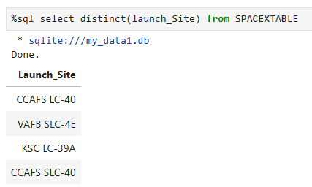
All Launch Site Names
To list all the unique launch sites found in the SPACEXTABLE, with no duplicates

Slide 25
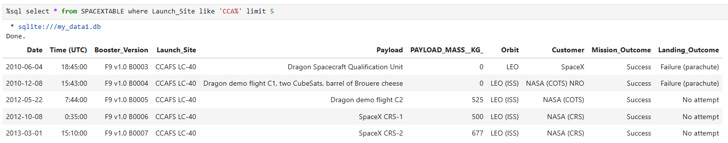
Launch Site Names Begin with 'CCA'
To retrieve the first 5 records from SPACEXTABLE where the launch site name starts with "CCA".

Slide 26
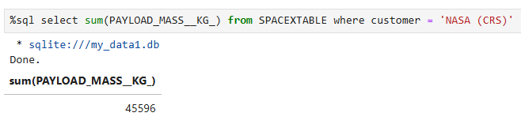
Total Payload Mass
To calculate the total payload mass (in kilograms) for all launches where the customer is "NASA (CRS)", using data from the SPACEXTABLE.

Slide 27
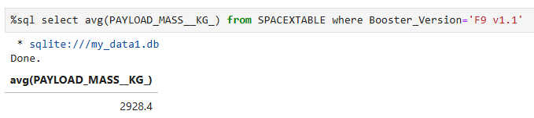
Average Payload Mass by F9 v1.1
To calculate the average payload mass (in kg) for launches that used the 'F9 v1.1' booster version, based on data from the SPACEXTABLE.

Slide 28
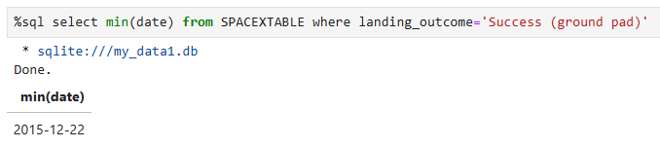
First Successful Ground Landing Date
To find the first or earliest launch date when the landing outcome was a successful landing on a ground pad, using data from the SPACEXTABLE.

Slide 29
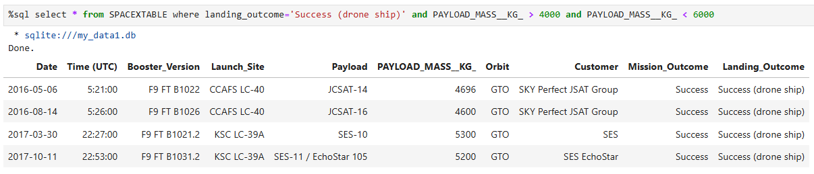
Successful Drone Ship Landing with Payload between 4000 and 6000
To retrieve all records from SPACEXTABLE where the landing was successful on a drone ship, and the payload mass is between 4000 and 6000 kilograms.

Slide 30
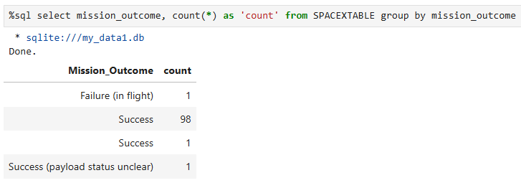
Total Number of Successful and Failure Mission Outcomes
To count how many times each mission outcome occurred in the SPACEXTABLE, and show the number of launches for each outcome.

Slide 31
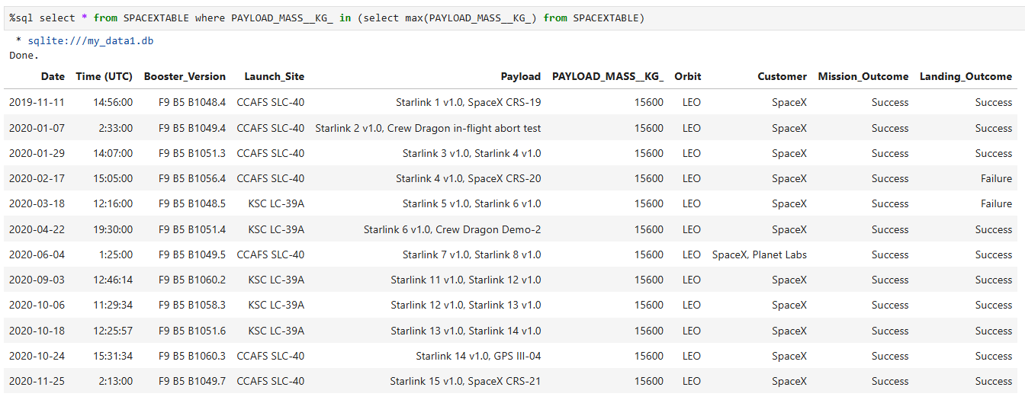
Boosters Carried Maximum Payload
To retrieve the full record(s) from SPACEXTABLE where the payload mass is the highest among all launches.

Slide 32
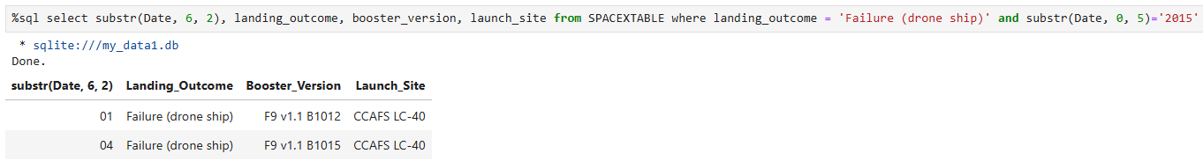
2015 Launch Records
To get the month (from the Date field), along with landing outcome, booster version, and launch site for launches in the year 2015 that had a failed landing on a drone ship.
SUBSTR(Date, 6, 2) extracts the month from the Date (assuming Date is in YYYY-MM-DD format).
SUBSTR(Date, 0, 5) = '2015' filters only the records from the year 2015.

Slide 33
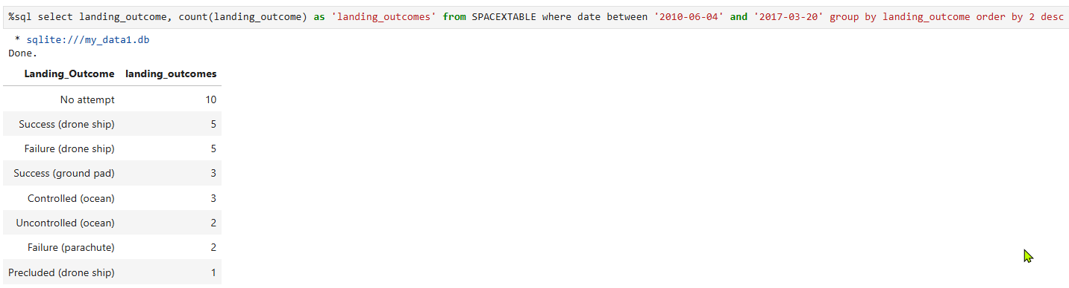
Rank Landing Outcomes Between 2010-06-04 and 2017-03-20
To count how many times each landing outcome occurred between June 4, 2010, and March 20, 2017, and list them in descending order of frequency.

Slide 34

Section 3

Slide 35
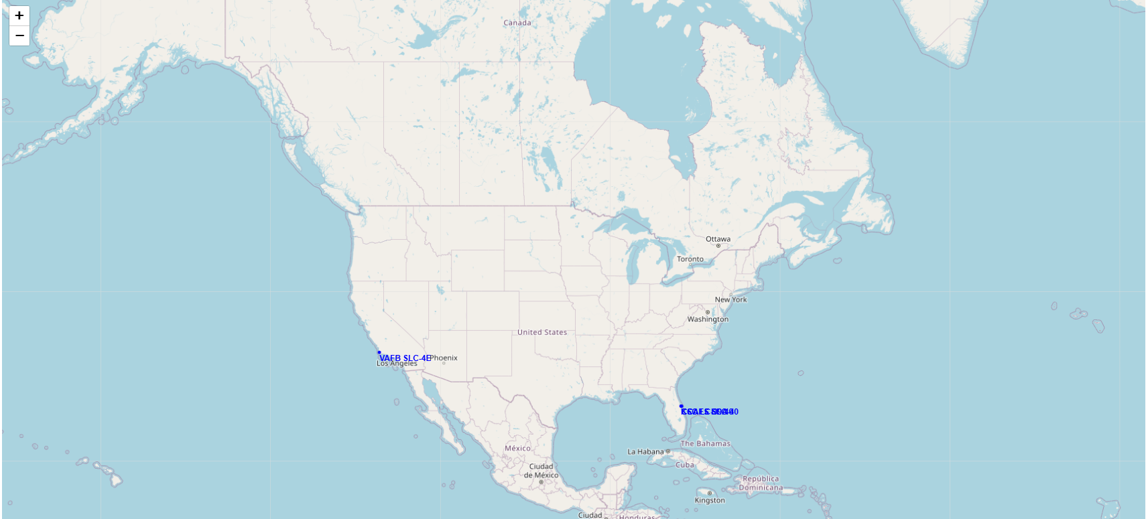
Launch Sites Global Map
Geographic map showing SpaceX launch sites (blue text labels) in North America, which are:
East Coast - Florida (CCAFS SLC-40 and KSC LC-39A)
West Coast - California (VAFB SLC-4E)

Slide 36
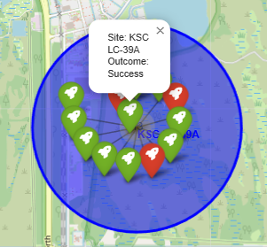
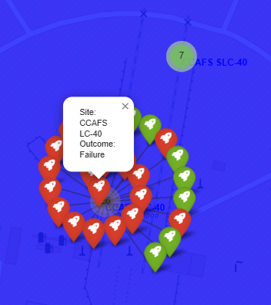
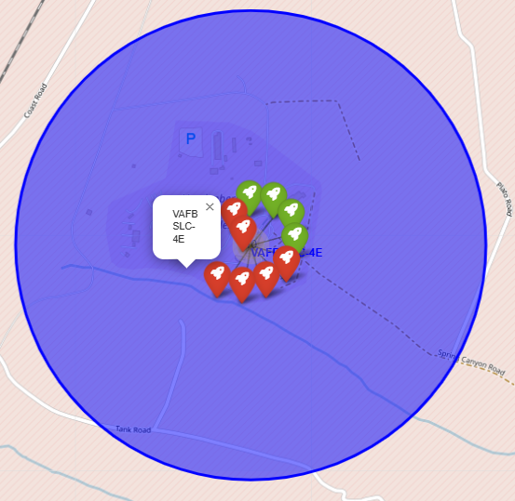
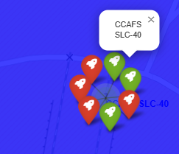
Launch Sites Outcome with Markers Color Labels
East Coast – Florida launch Sites (CCAFS SLC-40 and KSC LC-39A)
West Coast - California launch site (VAFB SLC-4E)
Green markers for Successful and Red markers for Unsuccessful launches

Slide 37
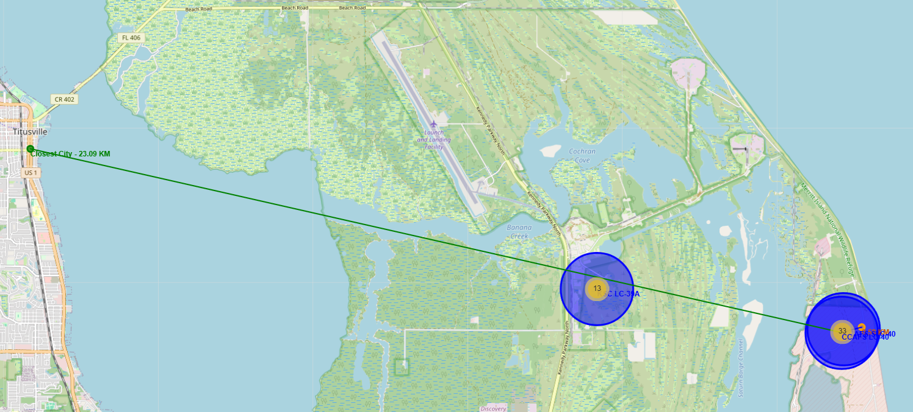
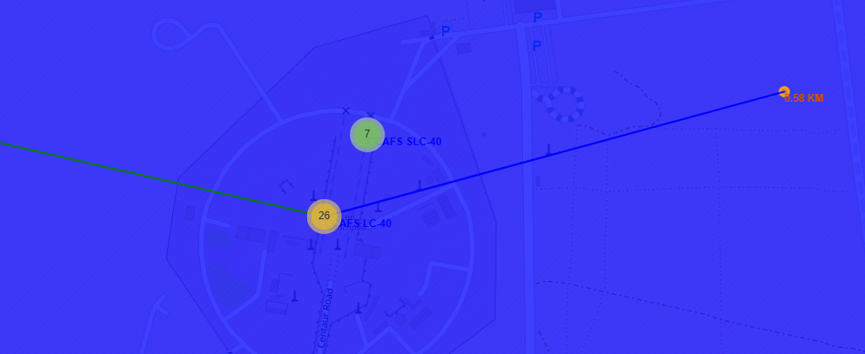
Launch Sites Distances Proximities
Railways: Moderate proximity - accessible but not too close.
Highways: Good proximity - easy access for transportation.
Coastline: Excellent proximity - right by water for safe launches.
Cities: Safe distance - far from populated areas like Titusville.
Summary: Launch sites are strategically placed near transportation and coastline for operational needs, but away from cities for safety. A Perfect balance of access and protection.

Slide 38

Section 4

Slide 39
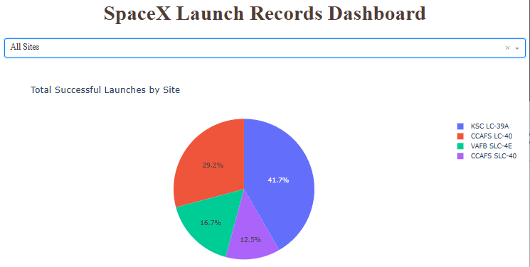
Total Successful Launches by Site
KSC LC-39A had the most successful launches (41.8%) among the launch sites.

Slide 40
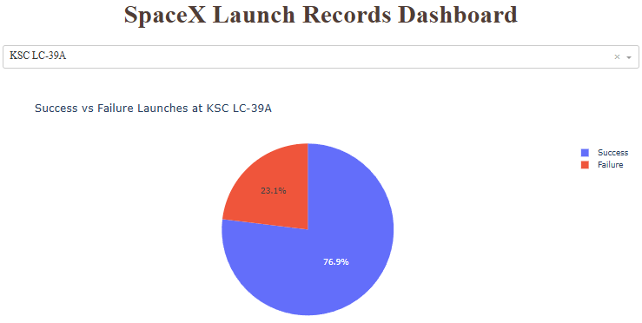
Launch Sites with the Highest Launch Success Ratio
KSC LC-39A achieved a 76.9% success rate, while getting a 23.1% failure rate.

Slide 41
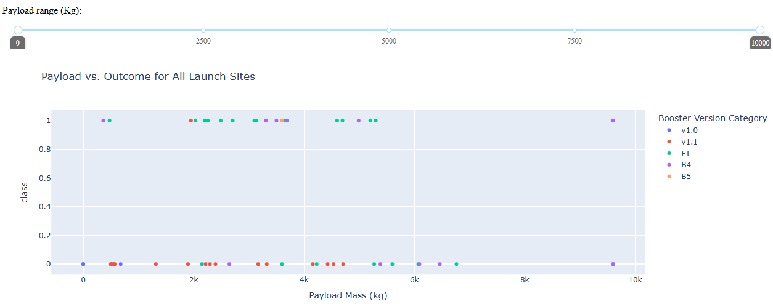
Payload Mass (kg) vs. Outcome for all Launch Sites
Most Successful Payload Range: Between 2,000 - 6,000 kg, especially with FT and B5 boosters.
Best Booster Versions: FT and B5 - lots of successes, very few or no failures.
Older Boosters (v1.0, v1.1): More failures, mostly with lower payloads (<4,000 kg).
Highest Payload (~10,000 kg): Rare but possible with B4 and can still succeed.

Slide 42

Section 5

Slide 43
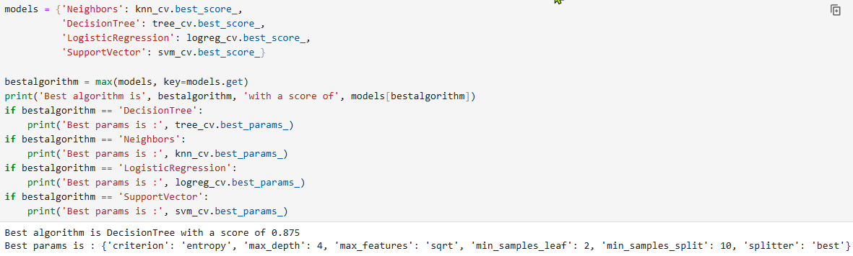
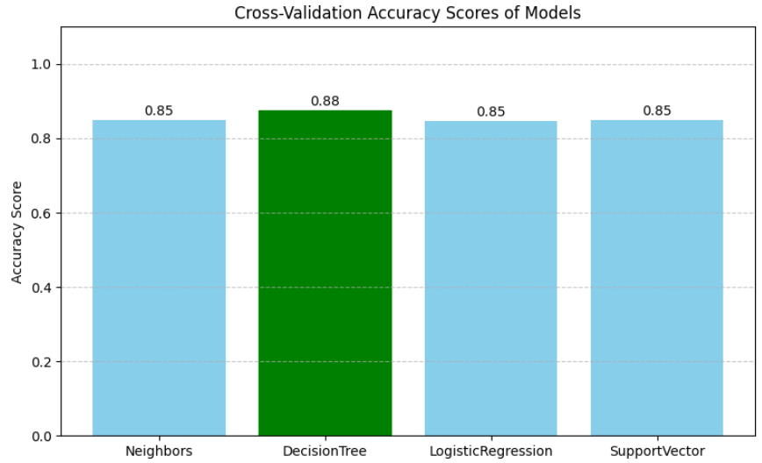
Classification Accuracy
The Decision Tree is the model that has the highest classification accuracy 88%.

Slide 44
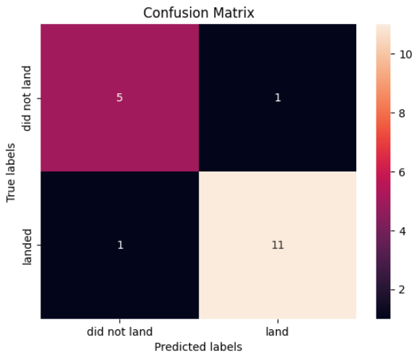
Confusion Matrix
Results:
True Negatives (TN): 5 (correct "did not land")
False Positives (FP): 1 (wrong "land" prediction)
False Negatives (FN): 1 (missed "land" prediction)
True Positives (TP): 11 (correct "land")
Performance:
Accuracy: 88% (16/18 correct predictions)
Precision: 91% (11/12 "land" predictions were right)
Recall: 91% (11/12 actual landings detected)
Summary:
Excellent performance with only 2 errors out of 18 predictions. The model is particularly strong at identifying successful landings.

Slide 45
Conclusions
Key Findings:
The greater the number of flights at a launch site, the greater the success rate at a launch site.
Payload 4,000 - 6,000kg is most successful.
Site CCAFS SLC 40 had the best performance.
100% Success Rate: GEO, HEO, SSO, ES-L1
With heavy payloads, the successful landing or positive landing rate is higher for Polar, LEO and ISS. However, for GTO, it's difficult to distinguish between successful and unsuccessful landings as both outcomes are present.
Launch success rate started to increase in 2013 till 2020.
Coastline: Excellent proximity - right by water for safe launches
KSC LC-39A had the most successful launches (41.8%) among the launch sites.
The Decision Tree is the model that has the highest classification accuracy (88.9%).

Slide 46
Appendix
SQL Queries:
Task 1: Display the names of the unique launch sites in the space mission
%sql select distinct(launch_Site) from SPACEXTABLE
Task 2: Display 5 records where launch sites begin with the string 'CCA'
%sql select * from SPACEXTABLE where Launch_Site like 'CCA%' limit 5
Task 3: Display the total payload mass carried by boosters launched by NASA (CRS)
%sql select sum(PAYLOAD_MASS__KG_) from SPACEXTABLE where customer = 'NASA (CRS)’
Task 4: Display average payload mass carried by booster version F9 v1.1
%sql select avg(PAYLOAD_MASS__KG_) from SPACEXTABLE where Booster_Version='F9 v1.1’
Task 5: List the date when the first succesful landing outcome in ground pad was acheived.
%sql select min(date) from SPACEXTABLE where landing_outcome='Success (ground pad)’
Task 6: List the names of the boosters which have success in drone ship and have payload mass greater than 4000 but less than 6000
%sql select * from SPACEXTABLE where landing_outcome='Success (drone ship)' and PAYLOAD_MASS__KG_ > 4000 and PAYLOAD_MASS__KG_ < 6000
Task 7: List the total number of successful and failure mission outcomes
%sql select mission_outcome, count(*) as 'count' from SPACEXTABLE group by mission_outcome
Task 8: List all the booster_versions that have carried the maximum payload mass, using a subquery with a suitable aggregate function.
%sql select * from SPACEXTABLE where PAYLOAD_MASS__KG_ in (select max(PAYLOAD_MASS__KG_) from SPACEXTABLE)
Task 9: List the records which will display the month names, failure landing_outcomes in drone ship ,booster versions, launch_site for the months in year 2015
%sql select substr(Date, 6, 2), landing_outcome, booster_version, launch_site from SPACEXTABLE where landing_outcome = 'Failure (drone ship)' and substr(Date, 0, 5)='2015’
Task 10: Rank the count of landing outcomes (such as Failure (drone ship) or Success (ground pad)) between the date 2010-06-04 and 2017-03-20, in descending order.
%sql select landing_outcome, count(landing_outcome) as 'landing_outcomes' from SPACEXTABLE where date between '2010-06-04' and '2017-03-20' group by landing_outcome order by 2 desc

Slide 47


